Slide 1


Presentation Skills
Dr. Abolfazl Saghafi
Assistant Professor of Statistics
Data Science Program Director
Notes:
Material for this presentation are adopted from ORAL PRESENTATION SKILLS: A PRACTICAL GUIDE, by C. STORZ and the English language teachers of the Institut national de télécommunications

Slide 2
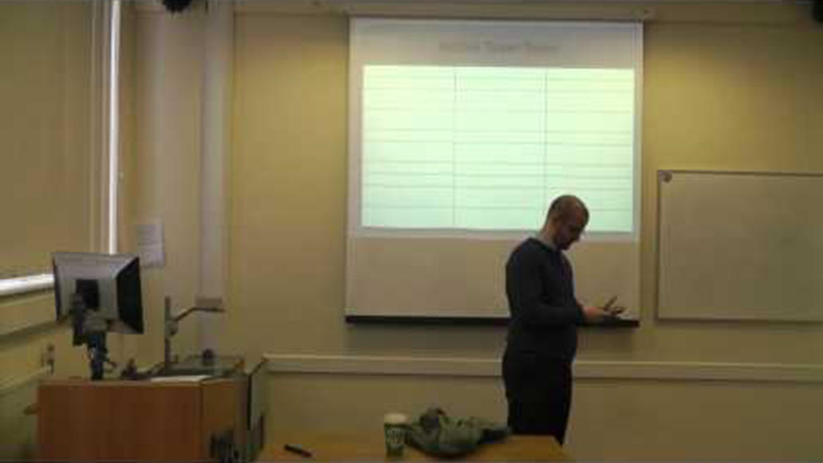
Notes:
How Many errors can you spot in this presentation?

Slide 3
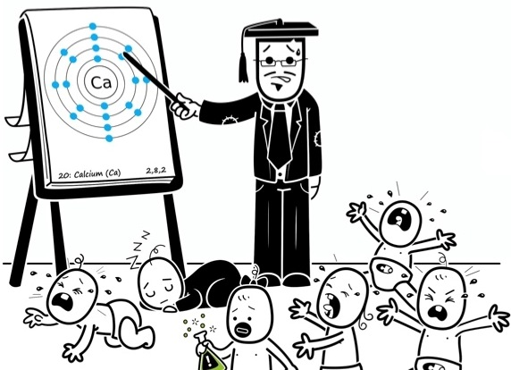
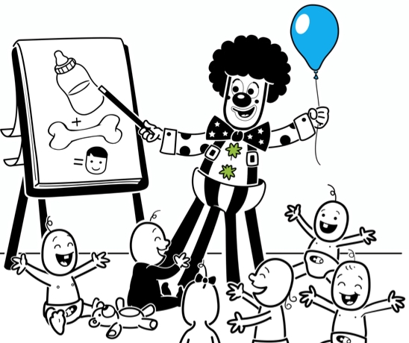
1. Planning
www.medicalwriters.com
This is a checklist of the essential elements to think about when preparing and planning an oral presentation.
1. What is your goal?
2. Who is your audience?
3. What are the main points you want to make?
4. What do you want the audience to do after listening to your presentation?
Notes:
• What is your goal? To sell a product? To inform and explain? To make a recommendation?
• Who is your audience since you should adjust your presentation based on the knowledge of the audience. Are they students in your field? What is their background knowledge? What sort of questions will they ask? What are the answers? How many people do you expect to attend?
• What are the main points you want to make?
• What do you want the audience to do after listening to your presentation? to buy your product? to accept your findings? to make better informed decisions? to give you a job?

Slide 4
How Long?
• It is extremely important to prepare your talk for the allotted time.
• Don’t finish a lot sooner than expected.
• Definitely, don’t go overtime.
When preparing, you should also consider the following items:
When?
• What day is it? What time of day is it?
• Will the audience be more or less receptive when listening in that time?
Where?
• Check beforehand, if you can, the place where you are going to make your presentation.
• How big is the room?
• What equipment is there in the room?
• What equipment do you need? Do they work?
• Do you need a pointer?
• Do you need an adapter or extension lead?
Note: Experienced presenters are able to improvise and adapt to changing circumstances but you may have only one chance to present your information, so be prepared.
Notes:
To give a successful presentation and at the same time a good image of yourself or your firm, careful preparation and organization are required. You need to take into consideration who you are speaking to, when, where, and why, as all of these details will have an impact on your structure and content. A well-structured speech with a step-bystep approach is one that is easy to follow.

Slide 5
2. Preparation
Notes
• On average, one slide is good for two minutes
• Don’t have more than
• to change focus from aural/oral to visual
• to motivate the audience
1. Title Page: Make sure you have a captivating title that captures interests of audience. Include your name, conference information and logo, date, company logo on the title page.
2. Text. Don’t include long sentences and proofs. Slides should only highlight the main points. Font should be large enough so everyone around the room can see them. Using colors works like a charm. The layout should be proper.

Slide 6
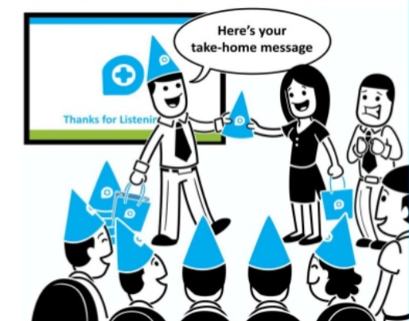
Visuals help
• to illustrate points easier than verbal
• to reinforce ideas
• to change focus from aural/oral to visual
• to motivate the audience
3. Visuals. Visuals such as graphs, maps, images, videos, models, effects, etc. speak volumes. Include them in your presentations but don’t over do it since it becomes distracting.
4. Handouts. Handouts that audience can take home make a lasting effect.
5. Notes. You may print a summary of your notes to practice and in case you forgot something as a reminder.
www.medicalwriters.com

Slide 7
3. Structure
Introduction
A good oral presentation is well structured; this makes it easier for the listener to follow.
Body
Basically there are three parts to a typical presentation: the beginning or introduction, the middle or body, and the end or conclusion.
We will look at each part in turn and present the language needed to express both the structure and the content.
Conclusion

Slide 8
3.1. The Introduction
• If you are giving a technical presentation a glossary might be useful and avoid unnecessary interruptions.
• Always explain abbreviations and say acronyms giving their full name when you first mention them and be especially careful with the pronunciation.
The beginning of a presentation is the most important part. It is when you establish a rapport with the audience and when you have their attention.
1. Signal the beginning
2. Greet audience
3. Introduce oneself
4. Give title and introduce subject
5. Give your objectives (purpose, aim, goals)
6. Make a transition between the introduction and the body.
Notes:
1. Signal the beginning. You could say: Alright. OK. Let's begin. Great. Can we start? Shall we start? Let's get the ball rolling. Let's get down to business. Etc.
2. Greet audience. It is important to greet the audience by saying something like: Hello ladies and gentlemen. Good morning members of the jury. Good afternoon esteemed guests. Good evening members of the board Fellow colleagues Mr. Chairman/Chairwoman. Thank you for your kind introduction.
3. Introduce oneself, (name, position, and company) . Do this not only to give important information so people can identify you but also to establish your authority on the subject and to allow the audience to see your point of view on the subject (you are a student, researcher, responsible for, director of, neophyte, layman).
4. Give title and introduce subject. What exactly are you going to speak about? Situate the subject in time and place, in relation to the audience and/or its importance. Give a rough idea or a working definition of the subject.
5. Give your objectives (purpose, aim, goals). You should have two purposes: a general purpose and a specific one. The former is to inform: to give an overview, to present, to summarize, to outline; to discuss the current situation or to explain how to do something or how something is done. The latter is what you want the audience to take away with them after listening to you, what you want them to do, what they should remember.
6. Make a transition between the introduction and the body. Now let us start.

Slide 9
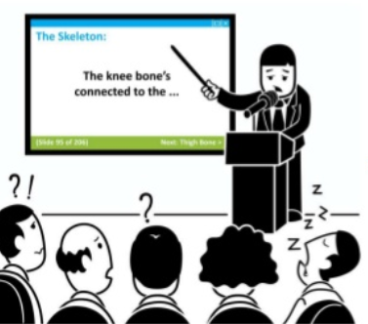
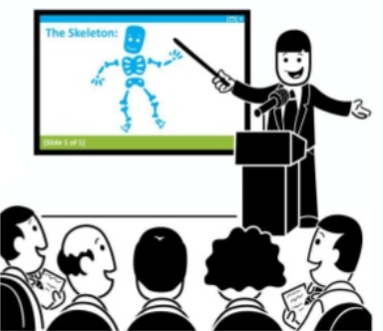
3.2. The Body
1. Content. All your information should support your purpose. In most cases you will have to limit the content, as time is precious!
2. Quantity. How much information should you give? Enough to clearly develop your ideas. Don’t forget to illustrate through examples.
www.medicalwriters.com
3. Sequencing your ideas. Some possibilities for organizing your ideas: logical; chronological order; from general to specific; problem/solution.
4. Keeping the audience's attention. The beginning and the end or the first and last parts of a talk are what listeners will remember best. Think of ways you can keep the audience's attention throughout the rest of the speech.
Notes:
Let your enthusiasm come out
Biggest element that separates mediocre presenters from world class ones is the ability to connect with audience in honest and exciting way.

Slide 10
3.3. The End
The end of a talk should never come as a surprise to an audience; it needs special consideration.
1. Summarize. briefly summarize your speech in a few lines to make sure the audience has retained the main points.
2. Conclusion. Give a message that logically comes out of the ideas developed in your speech.
3. Thank the audience for being there.
4. Ask for questions and comments or invite a discussion.
Notes:
How to deal with difficult questions?
1. Make sure you understand the question.
• Ask a question to see if you understood it
• Repeat the question in your own words to check that you have understood it correctly
• Ask the questioner to repeat if you didn’t get the question
2. In answering
• Check with the questioner if they are satisfied
• Admit that you don’t know a good answer

Slide 11
Body Language
Why is Body Lan. important?
It is a natural part of communication to clarify meaning, to vent nervousness, to maintain interest, to emphasize and regulate
Eye contact, facial expressions, posture, movements, gestures. Below are just a few examples of both positive and negative body language:
Positive body language:
• Eye contact to keep audiences' attention
• Facial expressions should be natural and friendly and don’t forget to smile
• Stand straight but relaxed (do not slouch or lean)
• Movement - to indicate a change of focus, to keep the audience's attention, i.e. move forward to emphasize
• Gesture, hand and arm gestures to show important points
Negative body language:
• lack of eye contact: looking at notes, screen, at the floor
• don't stare, or look blankly into people's eyes
• back turned to the audience
• nervous tics
• hands in pockets
Notes:
Pronunciation: Correct pronunciation is important if one is to be understood correctly. Incorrect pronunciation is perhaps the first cause of communication breakdown.
Voice: The voice, or more precisely the qualities of the voice, should be used to its fullest. Qualities include loudness, speed (fast or slow), variety, pitch (high or low), silent moments or pauses. The voice is important: to indicate importance, meaning to create atmosphere and to avoid sounding monotonous and putting the audience to sleep!

Slide 12

4. Practice
Feeling nervousness is normally due to
• lack of experience
• lack of preparation
• lack of enthusiasm
• negative self-talk.
Practicing helps to reduce nervousness and ensures a good delivery.
• Rehearse in front of a mirror
• Record yourself and watch it, you will get better significantly
• Anticipate audience questions and your responses, like a chess master
Notes:
I would stand in front of the mirror, look at myself and pretend that I was giving the actual presentation. Declamation pieces were easy to deliver as they required only memorization, but when I began to participate in extemporaneous speaking events and debate contests, I found that maintaining your composure in front of spectators was much more difficult as you feel rushed to formulate words, sentences and paragraphs in a time-sensitive setting.
A piece of advice that I found very useful was to always anticipate and plan for the worst-case scenarios. Don't expect everything to go as planned. Expect hard questions and even interruptions from hecklers. Read as much as you can and learn about every tangential issue that may be related to your presentation.
Once you have prepared your presentation, remember to put yourself in your audience's shoes. Ask yourself what questions could arise about this particular topic.
Once you have outlined and prepared, practice the delivery of your answers. This will greatly impact your conviction when you actually do answer. A hint of uncertainty can always be detected in your tone of voice, so to avoid this, practice, practice, practice.

Slide 13



